Slide 1
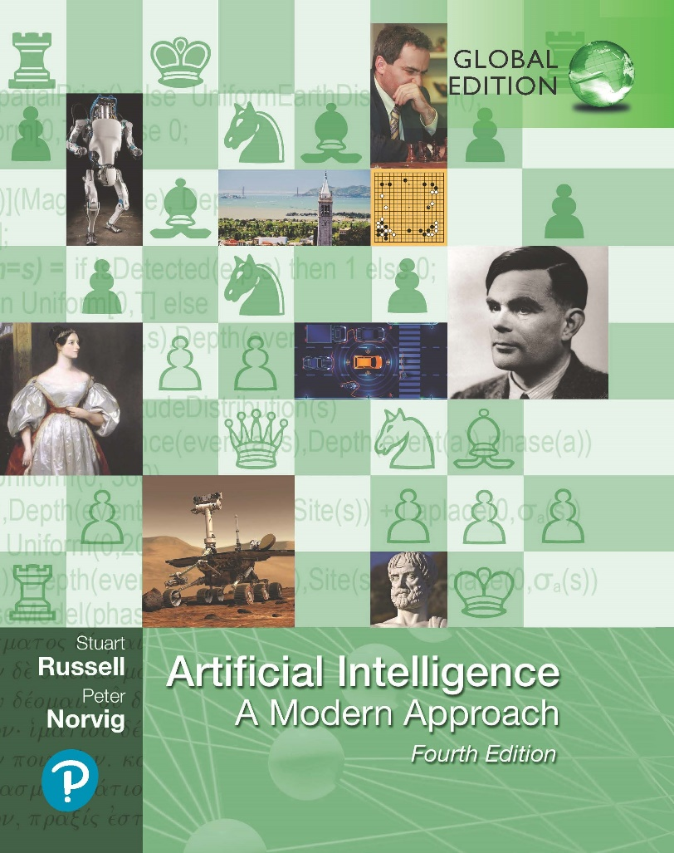
Artificial Intelligence: A Modern Approach
Fourth Edition, Global Edition
Chapter 20
Learning Probabilistic Models
© 2022 Pearson Education Ltd.

Slide 2
Outline
A Logical Formulation of Learning
Knowledge in Learning
Explanation-Based Learning
Learning Using Relevance Information
Inductive Logic Programming

Slide 3
A Logical Formulation of Learning
Extension of the predicate
hypothesis predicts that a certain set of examples will be examples of the goal predicate
Hypotheses that are not consistent with the examples can be ruled out
An example can be a false negative for the hypothesis
hypothesis says it should be negative but in fact it is positive
An example can be a false positive for the hypothesis
if the hypothesis says it should be positive but in fact it is negative

Slide 4
A Logical Formulation of Learning
Current-best-hypothesis search
maintain a single hypothesis, adjust it as new examples arrive in order to maintain consistency
If there is a new example that is false negative
Generalization: extension of hypothesis increased to include false negative,
If there is a new example that is false positive
Specialization: extension of the hypothesis must be decreased to exclude
the example.
Generalization & specialization are logical relationships between hypotheses
If hypothesis h₁, with definition C₁, is a generalization of hypothesis h₂ with definition C₂,
∀ x C₂(x) ⇒ C₁(x)
to construct a generalization of h: find a definition C₁ that is logically implied by C₂.
dropping conditions: generates a weaker definition & allows a larger set of positive examples

Slide 5
A Logical Formulation of Learning
X₁, is positive. The attribute Alternate(X₁) is true,
h₁ : ∀ x WillWait(x) ⇔ Alternate(x)
X₂, is negative. h₁ predicts it to be positive, so it is a false positive. Specialize h₁
h₂ : ∀ x WillWait(x) ⇔ Alternate(x) ∧ Patrons(x, Some)
X₃, is positive. h₂ predicts it to be negative, so it is a false negative. to generalize h₂.
h₃ : ∀ x WillWait(x) ⇔ Patrons(x, Some)
X₄, is positive. h₃ predicts it to be negative, so it is a false negative.
Cannot drop Patrons condition it yields an all inclusive hypothesis, add disjunct
h₄ : ∀ x WillWait(x) ⇔ Patrons(x, Some)∨ (Patrons(x, Full) ∧ Fri/Sat(x)) .

Slide 6
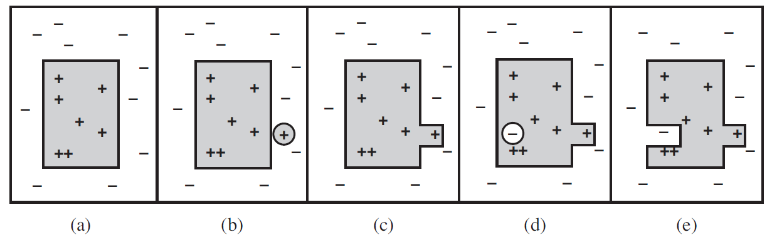
A Logical Formulation of Learning
A consistent hypothesis.
A false negative.
The hypothesis is generalized.
A false positive.
The hypothesis is specialized.

Slide 7
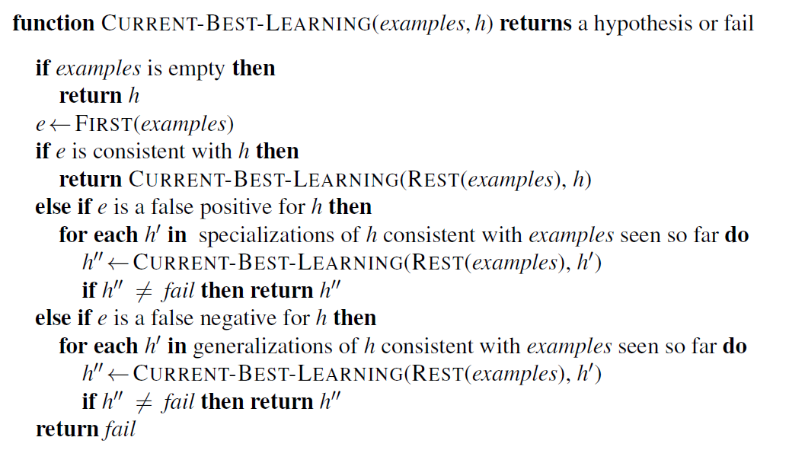
A Logical Formulation of Learning
The current-best-hypothesis learning algorithm. It searches for a consistent hypothesis that fits all the examples and backtracks when no consistent specialization/ generalization can be found. To start the algorithm, any hypothesis can be passed in; it will be specialized or gneralized as needed

Slide 8
A Logical Formulation of Learning
Least-commitment search
keep around all & only those hypotheses that are consistent with all the data
new example will either have no effect or will get rid of some of the hypotheses
The set of hypotheses remaining: version space
incremental: one never has to go back and reexamine the old examples.
ordering on the hypothesis space, namely, generalization/specialization
boundary set: each boundary will be a set of hypothesis consistent with all observations so far. Has two boundaries:
most general boundary (the G-set)
no consistent hypotheses that are more specific
most specific boundary (the S-set)
No consistent hypotheses that are more general.

Slide 9
A Logical Formulation of Learning
Least-commitment search
The general structure of the boundary-set representation of the version space to be sufficient it has to have two properties:
Every consistent hypothesis (other than those in the boundary sets) is more specific than some member of the G-set, and more general than some member of the S-set
Every hypothesis more specific than some member of the G-set and more general than some member of the S-set is a consistent hypothesis
members S_{i} and G_{i} of the S- and G-sets.
False positive for S_{i}: S_{i} too general, throw it out of the S-set
False negative for S_{i}: S_{i} too specific, replace it by all its immediate generalizations
False positive for G_{i}: G_{i} too general, replace it by all its immediate specializations
False negative for G_{i}: G_{i} too specific, throw it out of the G-set

Slide 10
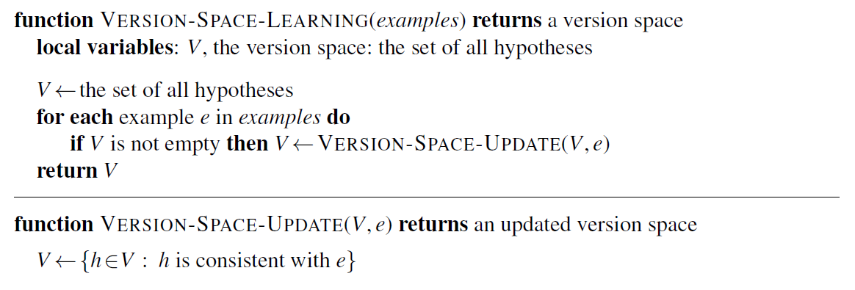
A Logical Formulation of Learning
The version space learning algorithm. It finds a subset of V that is consistent with all the examples.

Slide 11
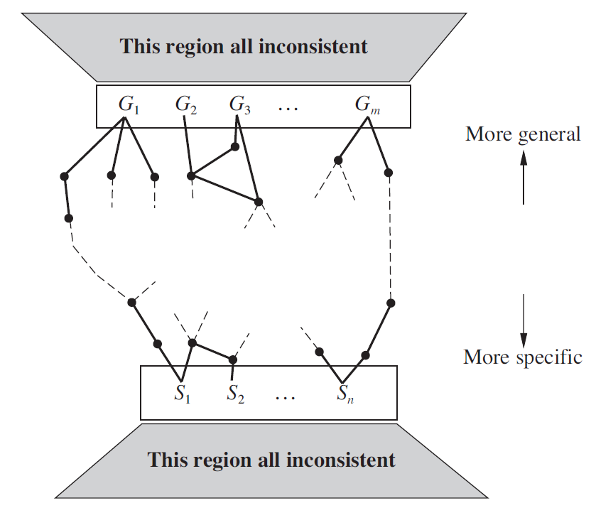
A Logical Formulation of Learning
The version space contains all hypotheses consistent with the examples.

Slide 12
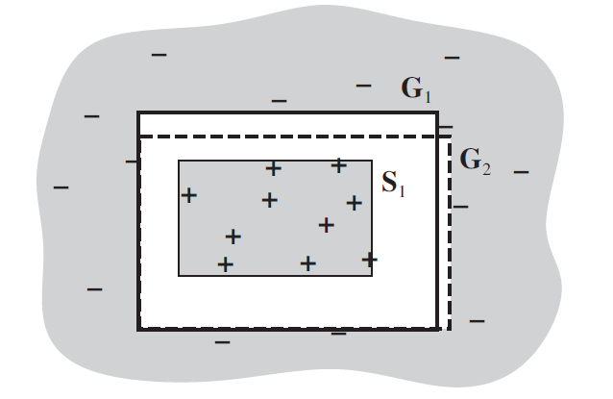
A Logical Formulation of Learning
The extensions of the members of G and S. No known examples lie in between the two sets of boundaries.

Slide 13
Knowledge in Learning
Entailment constraint
Hypothesis∧Descriptions⊨Classifications
modern approach is to design agents that already know something and are trying to learn some more.
Explanation based learning, or EBL
follows logically from the background knowledge
the agent does not actually learn any thing factually new from the example
Hypothesis∧Descriptions ⊨ Classifications
Background ⊨ Hypothesis .
Relevance-based learning, or RBL
concerns the relevance of a set of features to the goal predicate.
This knowledge with the observations, allows the agent to infer a new, general rule that explains the observations:
Hypothesis∧Descriptions ⊨ Classifications ,
Background ∧Descriptions∧Classifications ⊨ Hypothesis .
deductive form of learning and cannot by itself account for the creation of new knowledge starting from scratch

Slide 14
Knowledge in Learning
knowledge-based inductive learning, or KBI
the background knowledge and the new hypothesis combine to explain the examples
studied mainly in the field of inductive logic programming, or ILP
prior knowledge plays two key roles in reducing the complexity of learning
The effective hypothesis space size is reduced to include only those theories that are consistent with what is already known
The size of the hypothesis required to construct an explanation for the observations can be much reduced, because the prior knowledge will be available to help out the new rules in explaining the observations

Slide 15
Explanation-Based Learning
Entailment constraint
Hypothesis∧Descriptions⊨Classifications
modern approach is to design agents that already know something and are trying to learn some more.
Explanation based learning, or EBL
follows logically from the background knowledge
the agent does not actually learn any thing factually new from the example
Hypothesis∧Descriptions ⊨ Classifications
Background ⊨ Hypothesis .
Relevance-based learning, or RBL
concerns the relevance of a set of features to the goal predicate.
This knowledge with the observations, allows the agent to infer a new, general rule that explains the observations:
Hypothesis∧Descriptions ⊨ Classifications ,
Background ∧Descriptions∧Classifications ⊨ Hypothesis .
deductive form of learning and cannot by itself account for the creation of new knowledge starting from scratch

Slide 16
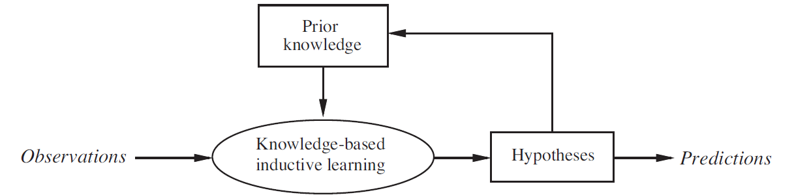
Explanation-Based Learning
A cumulative learning process uses, and adds to, its stock of background knowledge over time.

Slide 17
Explanation-Based Learning
Explanation-based learning (EBL) is a method for extracting general rules from individual observations.
Memoization: accumulate a database of input–output pairs; when the function is called
EBL create general rules that cover an entire class of cases
EBL general process:
1. Given an example, construct a proof that the goal predicate applies to the example using the available background knowledge.
2. In parallel, construct a generalized proof tree for the variabilized goal using the same inference steps as in the original proof.
3. Construct a new rule whose left-hand side consists of the leaves of the proof tree and whose right-hand side is the variabilized goal (after applying the necessary bindings from the generalized proof).
4. Drop any conditions from the left-hand side that are true regardless of the values of the variables in the goal.

Slide 18
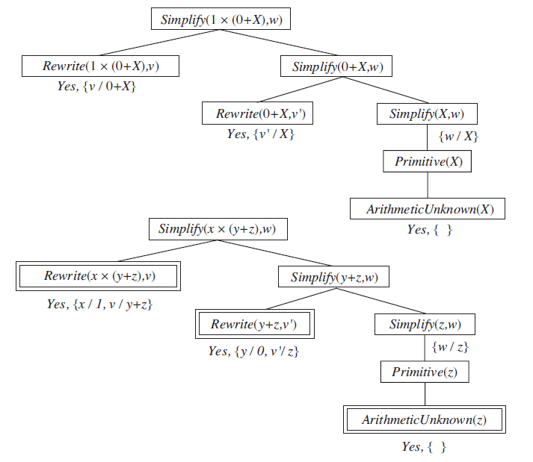
Explanation-Based Learning
Proof trees for the simplification problem. The first tree shows the proof for the original problem instance. The second tree shows the proof for a problem instance with all constants replaced by variables, from which we can derive a variety of other rules.

Slide 19
Explanation-Based Learning
Improving efficiency
The generalized proof tree actually yields more than one generalized rule.
if we terminate, or prune, the growth of the right-hand branch in the proof tree when it reaches the Primitive step, we get the rule
Primitive(z) ⇒ Simplify(1 × (0 + z),
extract a more general rule by pruning after the step Simplify(y + z, w), yielding the rule
Simplify(y + z, w) ⇒ Simplify(1 × (y + z), w) .
There are three factors involved in the analysis of efficiency gains from EBL
branching factor increases when large numbers of rules are added
derived rules must offer significant increases in speed for the cases that they do cover.
Derived rules should be as general as possible, so that they apply to the largest possible set of cases.

Slide 20
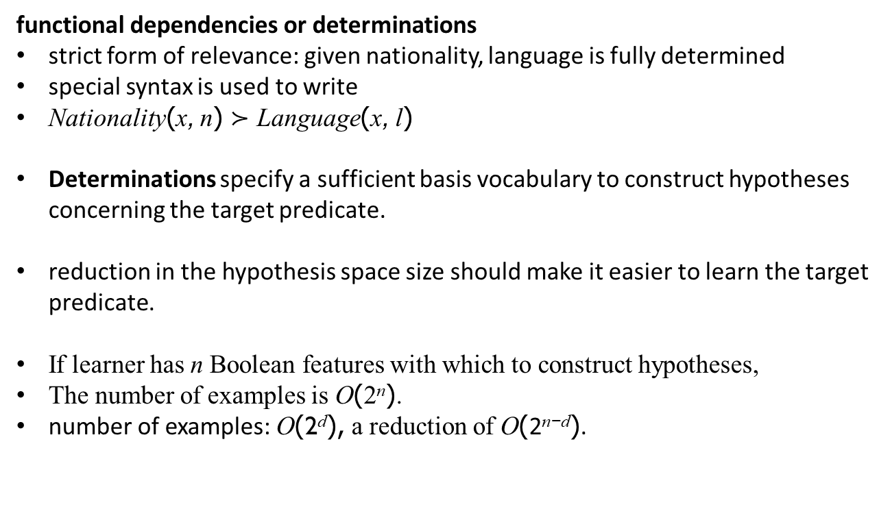
Learning Using Relevance Information
functional dependencies or determinations
strict form of relevance: given nationality, language is fully determined
special syntax is used to write
Nationality(x, n) $≻$ Language(x, l)
Determinations specify a sufficient basis vocabulary to construct hypotheses concerning the target predicate.
reduction in the hypothesis space size should make it easier to learn the target predicate.
If learner has n Boolean features with which to construct hypotheses,
The number of examples is O(2^{n}).
number of examples: O(2^{d}), a reduction of O(2^{n−d}).

Slide 21
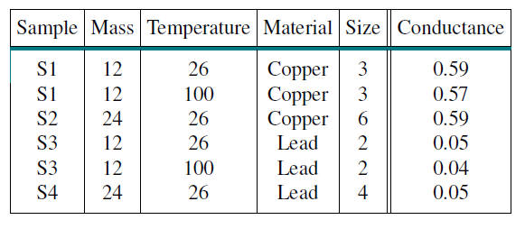
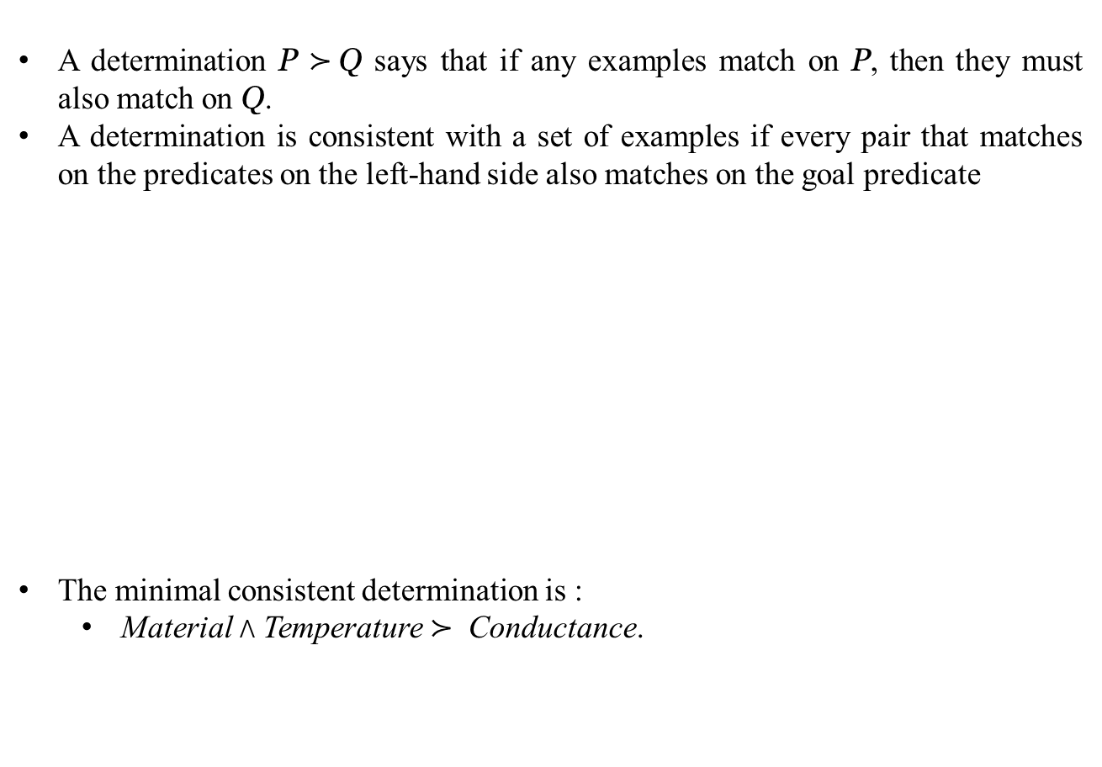
Learning Using Relevance Information
A determination P $≻$Q says that if any examples match on P, then they must also match on Q.
A determination is consistent with a set of examples if every pair that matches on the predicates on the left-hand side also matches on the goal predicate
The minimal consistent determination is :
Material ∧ Temperature $≻$ Conductance.

Slide 22
Inductive Logic Programming
Inductive logic programming (ILP) combines inductive methods with the power of first-order representations,
Concentrating on the representation of hypotheses as logic programs
Top-down inductive learning methods
starts with a very general rule and gradually specializing it so that it fits the data
use first-order literals instead of attributes
hypothesis is a set of clauses

Slide 23
Inductive Logic Programming
Using FOIL to learn a definition of the Grandfather(x, y) predicate,
constructs a set of clauses, each with Grandfather(x, y) as the head.
Father(x, z) ∧ Parent(z, y) ⇒ Grandfather(x, y)
Father(x, z) ∧ Father(z, y) ⇒ Grandfather(x, y)
Father(x, z) ∧ Mother(z, y) ⇒ Grandfather(x, y) .
FOIL will have to search through many unsuccessful clauses before finding a correct solution
constructs a clause, literal by literal, until agrees with
some subset of the positive examples
none of the negative examples
positive examples covered by the clause are removed from the training set,
process continues until no positive examples remain
FOIL has two main subroutines
NEW-LITERALS, which constructs all possible new literals to add to the clause,
CHOOSE-LITERAL, which selects a literal to add.

Slide 24
Inductive Logic Programming
Three kinds of literals that can be added:
Literals using predicates:
the literal can be negated or unnegated,
any existing predicate (including the goal predicate) can be used,
the arguments must all be variables
literal must include at least one variable from an earlier literal or from the head of the clause.
Equality and inequality literals:
relate variables already appearing in the clause
Arithmetic comparisons:
when dealing with functions of continuous variables, literals such as x > y and y ≤ z can be added.
CHOOSE-LITERAL uses a heuristic somewhat similar to information gain
Ockham’s razor to eliminate some hypotheses.

Slide 25
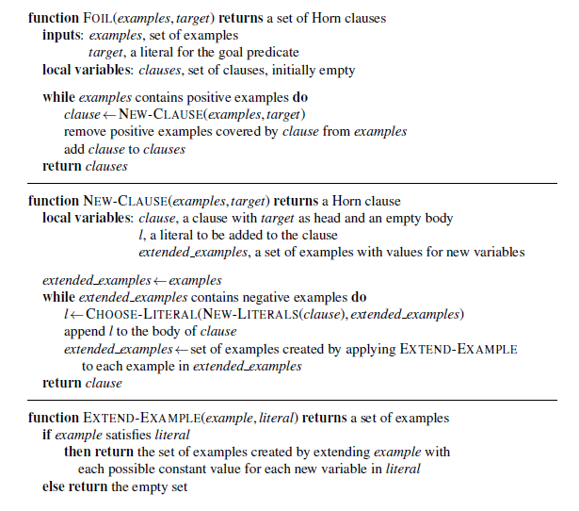
Inductive Logic Programming
Sketch of the FOIL algorithm for learning sets of first-order Horn clauses from examples. NEW-LITERALS and CHOOSE-LITERAL

Slide 26
Inductive Logic Programming
Inductive learning with inverse deduction
An inverse resolution step takes a resolvent C and produces two clauses C₁ and C₂, such that C is the result of resolving C₁ and C₂.
Alternatively, it may take a resolvent C and clause C and produce a clause C₂ such that C is the result of resolving C₁ and C₂.
Example: resolvent C to be empty clause and C₂ to be ¬Grandparent(George, Anne),
first inverse step takes C and C₂ and generates Grandparent(George, Anne) for C₁.
¬Parent(Elizabeth, y) ∨Grandparent(George, y)
Parent(x, z) ∧ Parent(z, y) ⇒ Grandparent(x, y) .

Slide 27
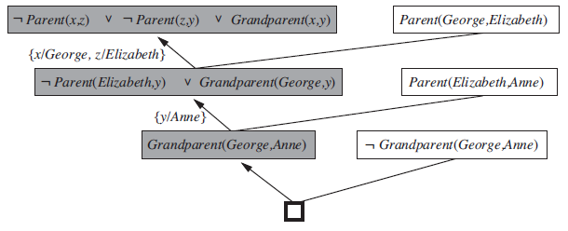
Inductive Logic Programming
Inductive learning with inverse deduction
Early steps in an inverse resolution process. The shaded clauses are generated by inverse resolution steps from the clause to the right and the clause below. The unshaded clauses are from the Descriptions and Classifications (including negated Classifications).

Slide 28
Summary
The use of prior knowledge in learning leads to a picture of cumulative learning
Understanding the different logical roles played by prior knowledge, as expressed by entailment constraints, helps to define a variety of learning techniques
Explanation-based learning (EBL) extracts general rules from single examples by explaining the examples and generalizing the explanation.
Relevance-based learning (RBL) uses prior knowledge in the form of determinations to identify the relevant attributes
Knowledge-based inductive learning (KBIL) finds inductive hypotheses that explain sets of observations with the help of background knowledge.
Inductive logic programming (ILP) techniques perform KBIL on knowledge that is
expressed in first-order logic.
ILP can be done with a top-down approach of refining a very general rule or through abottom-up approach of inverting the deductive process.

